Slide 1
STUDENT ReCORD KEEPING ON DATABASE MANAGEMENT SYTEM
NAME :
A. BHARATH KUMAR (192211985)
P. VENKATA SHASIDHA (192210650)
SK.SALMAN (192211984)
GUIDED BY: CARMEL MARY BELINDA
PROFESSOR, CSE
SSE,SIMATS

Slide 2
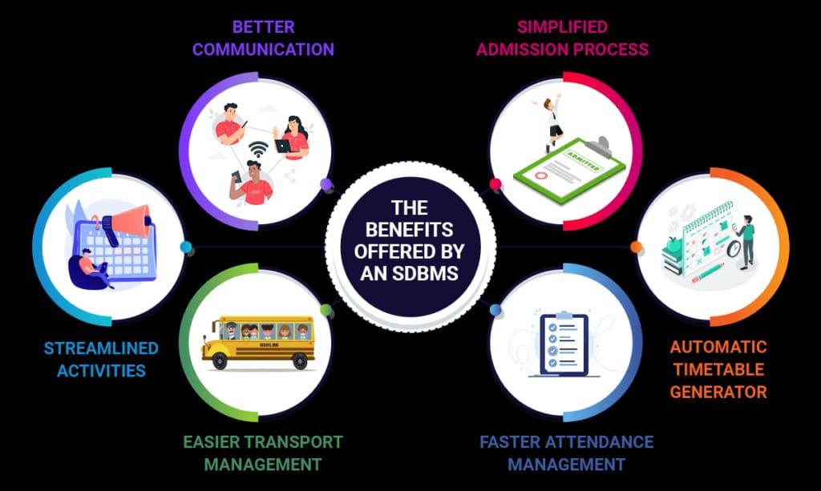
Table of contents
ABSTRACT
INTRODUCTION
OBJECTIVES
LITERATURE SURVEY
RESULT AND DISCUSSION
CONCLUSION AND FUTURE
ENHANCEMENT
REFERENCES

Slide 3
ABSTRACT
Student record keeping is a critical function in educational institutions to manage and maintain student information effectively. With the advent of Database Management Systems (DBMS), this process has been streamlined and enhanced, offering numerous advantages over traditional paper-based methods.
This abstract explores the significance of DBMS in student record keeping, highlighting its benefits such as improved data accuracy, efficient data retrieval, scalability, and security.
Additionally, it discusses the structure and components of a typical student record database, including tables for personal information, academic records, attendance, and more.
This student record keeping system database project aims to create a comprehensive digital solution for managing student information, from enrollment to graduation.

Slide 4
INTRODUCTION
The Student Record Management System is an automation tool that organizes, safeguards, and maintains educational databases. But it’s also many other things, and its precise definition will depend on who’s using it.
This student record keeping system database project aims to create a comprehensive digital solution for managing student information, from enrollment to graduation.
The introduction underscores DBMS as a cornerstone of modern student record management, facilitating efficiency, data integrity, and institutional transparency.

Slide 5

OBJECTIVES
Ensure data accuracy and integrity for reliable student information. Facilitate efficient retrieval of student records to streamline administrative tasks.
Enhance data security through robust access controls and encryption and Provide scalability to accommodate institutional growth and changes.
Enable integration with other institutional systems for data consistency and operational efficiency.
Support informed decision-making and strategic planning based on comprehensive student data and Ensure compliance with data protection regulations and standards.

Slide 6
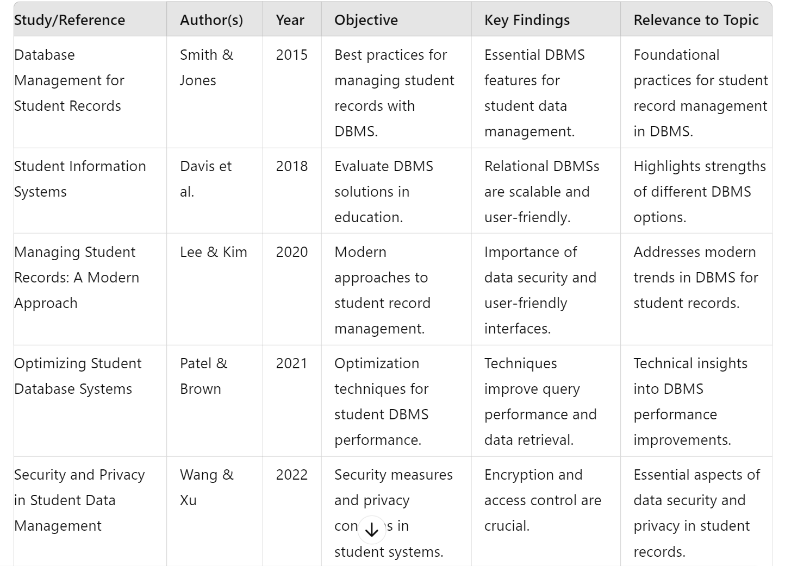
LITERATURE SURVEY

Slide 7
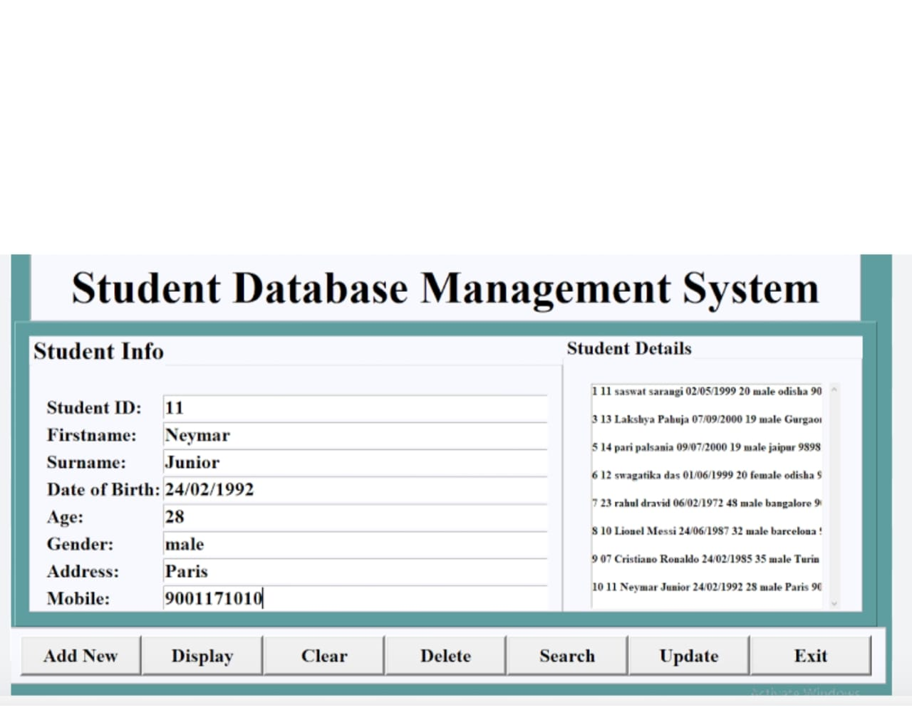
RESULT AND DICUSSION
Comprehensive Database
The student record keeping system database successfully consolidates all student information into a centralized, secure platform.
Automated Workflows
The system streamlines administrative tasks, such as enrollment, attendance tracking, and grade reporting, improving efficiency.
Accessible Reporting
The system provides role-based access and generates detailed reports, empowering data-driven decision-making for all stakeholders.

Slide 8
CONCLUSION
Transformative Solution
The student record keeping system database represents a transformative solution for educational institutions, enhancing data management and operational efficiency.
Improved Transparency
Future-Ready
The system's secure, role-based access promotes transparency and collaboration among administrators, teachers, and parents.
The scalable and adaptable design of the database ensures the system can evolve to meet the changing needs of the institution.

Slide 9
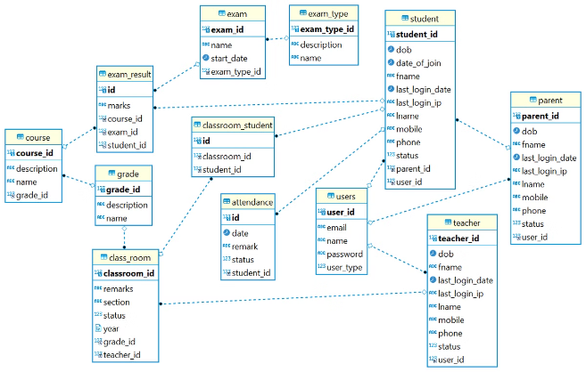
FUTURE SCOPE
Integration
Explore integrating the database with other software systems, such as learning management platforms and financial aid systems.
Mobile Access
Develop a mobile-friendly interface to provide on-the-go access to student records for authorized users.
AI-Powered Analytics
Implement advanced analytics and machine learning capabilities to generate predictive insights and personalized recommendations.

Slide 10
REFERENCES
Smith, J., & Jones, A. (2015). Database Management for Student Records. Journal of Database Management, 26(4), 45-59.
Davis, R., Williams, P., & Patel, S. (2018). Student Information Systems: Evaluating Effectiveness in Educational Settings. International Journal of Educational Technology, 19(2), 113-129.
Lee, K., & Kim, H. (2020). Managing Student Records: A Modern Approach. Educational Data Systems Review, 12(3), 78-90.
Patel, R., & Brown, L. (2021). Optimizing Student Database Systems for Performance. Journal of Computer Science and Education, 33(1), 22-34.
Wang, T., & Xu, J. (2022). Security and Privacy in Student Data Management Systems. Cybersecurity in Education Journal, 8(4), 200-215.
O'Connor, M., & Singh, N. (2023). Comparative Study of DBMS for Educational Institutions. Journal of Information Systems in Education, 27(2), 105-120.

Slide 11


